Slide 1
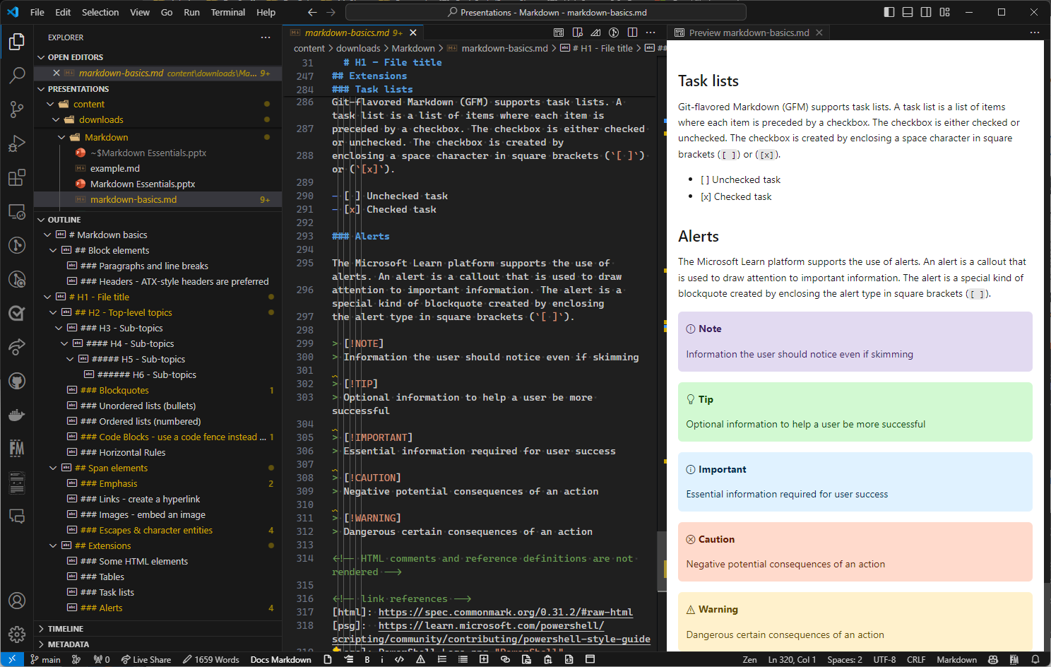

Markdown Essentials

Slide 2

What is Markdown?
A simple markup language (like HTML) for plaintext documents.
Developed in 2004 by John Gruber in collaboration with Aaron Swartz
First markdown-to-html converter written in Perl

Slide 3
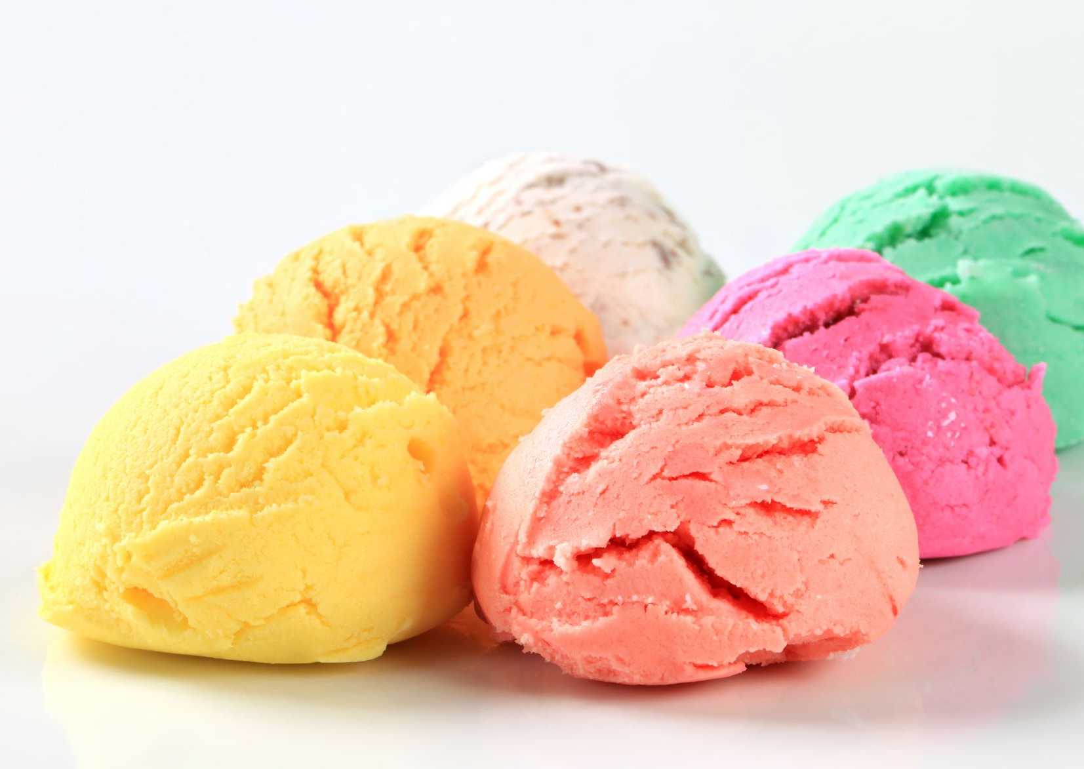
Flavors of Markdown
CommonMark
GFM
Extensions - tables, docs extensions

Slide 4
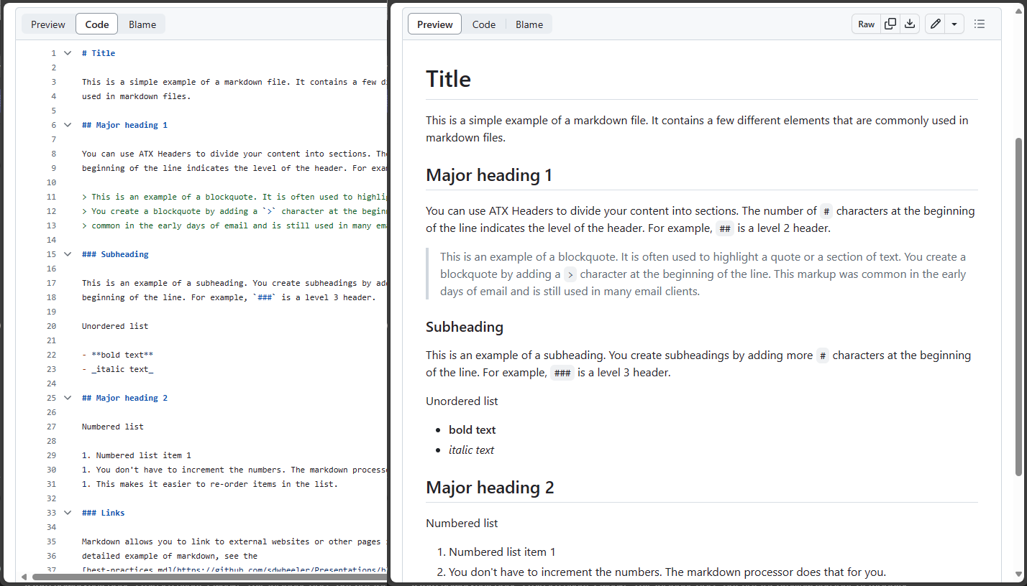
Basic markup
Markdown goals
Maintain readability of the plaintext
Minimize the complexity of the markup
Easily transformed to HTML

Slide 5

Use cases
Documentation
PowerShell help – platyPS
All content on https://learn.microsoft.com
Blogging
Supported by Word Press
PowerShell-Community blog
Hugo static site generator
Chat and social media
Teams chat
Discord
Reddit
Note-taking
Obsidian

Slide 6
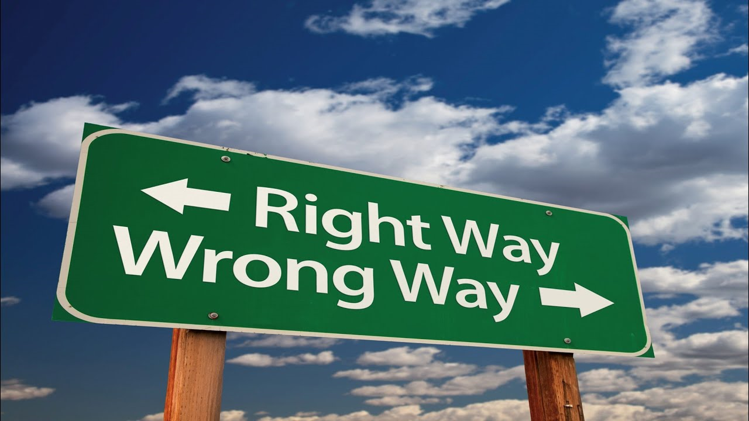

Best practices
PowerShell style guide
Standardized markup choices
100-char limit - semantic line breaks
Blank lines after blocks
Blocks vs. spans
VS Code tools
Learn extension
Reflow
Table formatter + Excel
Gremlins
Preview
Other extensions

